Slide 1
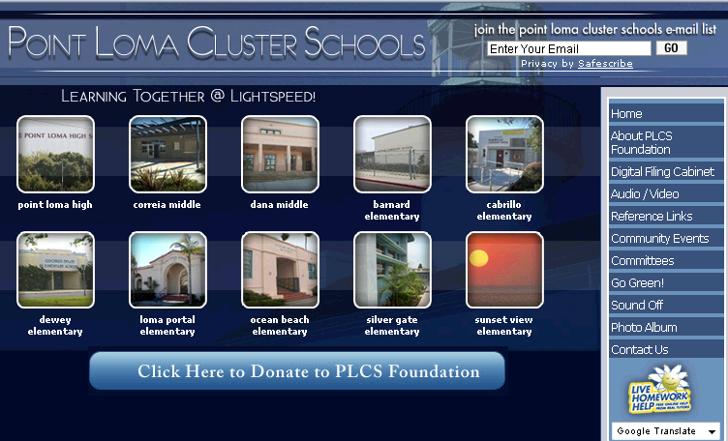
Point Loma Cluster
Demographics and Assessment Information
September 2009
Reference Source: California Department of Education

Slide 2
About the Point Loma Cluster
The Point Loma Cluster consists of ten public schools located in the Point Loma area of San Diego, California. Part of the San Diego Unified School District, the Cluster has 10 schools which serve over 6,000 students in grades K-12.
About the Point Loma Cluster Schools Foundation (PLCS)
In 2006, a group of parents, teachers, and principals from each school engaged in a strategic planning process to develop a unified vision for the Point Loma Cluster. Called the Point Loma Cluster Schools Foundation (PLCS ).
PLCS Vision
The Point Loma Cluster Schools, through innovative practices and collaborative efforts, will be the model of educational excellence; inspiring passionate life-long learners, critical thinkers, unbounded achievers, and responsible global citizens.
www.pointlomacluster.com

Slide 3
Cluster Leadership
Cluster Schools (Grades) Principal
Sunset View (K-4) Jackie McCabe
Silver Gate (K-4) Sandy McClure
Ocean Beach ((K-4) Margaret Johnson
Loma Portal (K-4) Glenda Gerde
Cabrillo (K-4) Nestor Suarez
Dewey (K-4) Tanya Belsan
Barnard (K-4) Ed Park
Dana Middle (5-6) Diane Ryan
Correia Middle (6-8) Patty Ladd
Point Loma HS (9-12) Bobbie Samilson
District Administration / School Board
Grades K thru 4
SIO Mitz Merino
CIO Grenita Lathan
Grades 6-8
SIO Robert Grano
CIO Sid Salazar
High School (PLHS)
SIO Dianna Carrberry
CiO Sid Salazar
School Board Representative
John de Beck

Slide 4
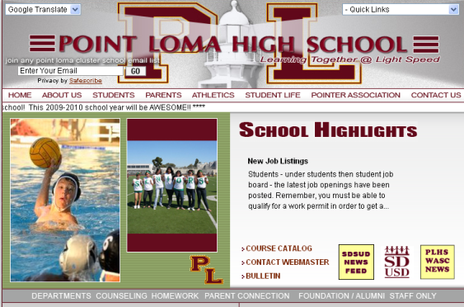
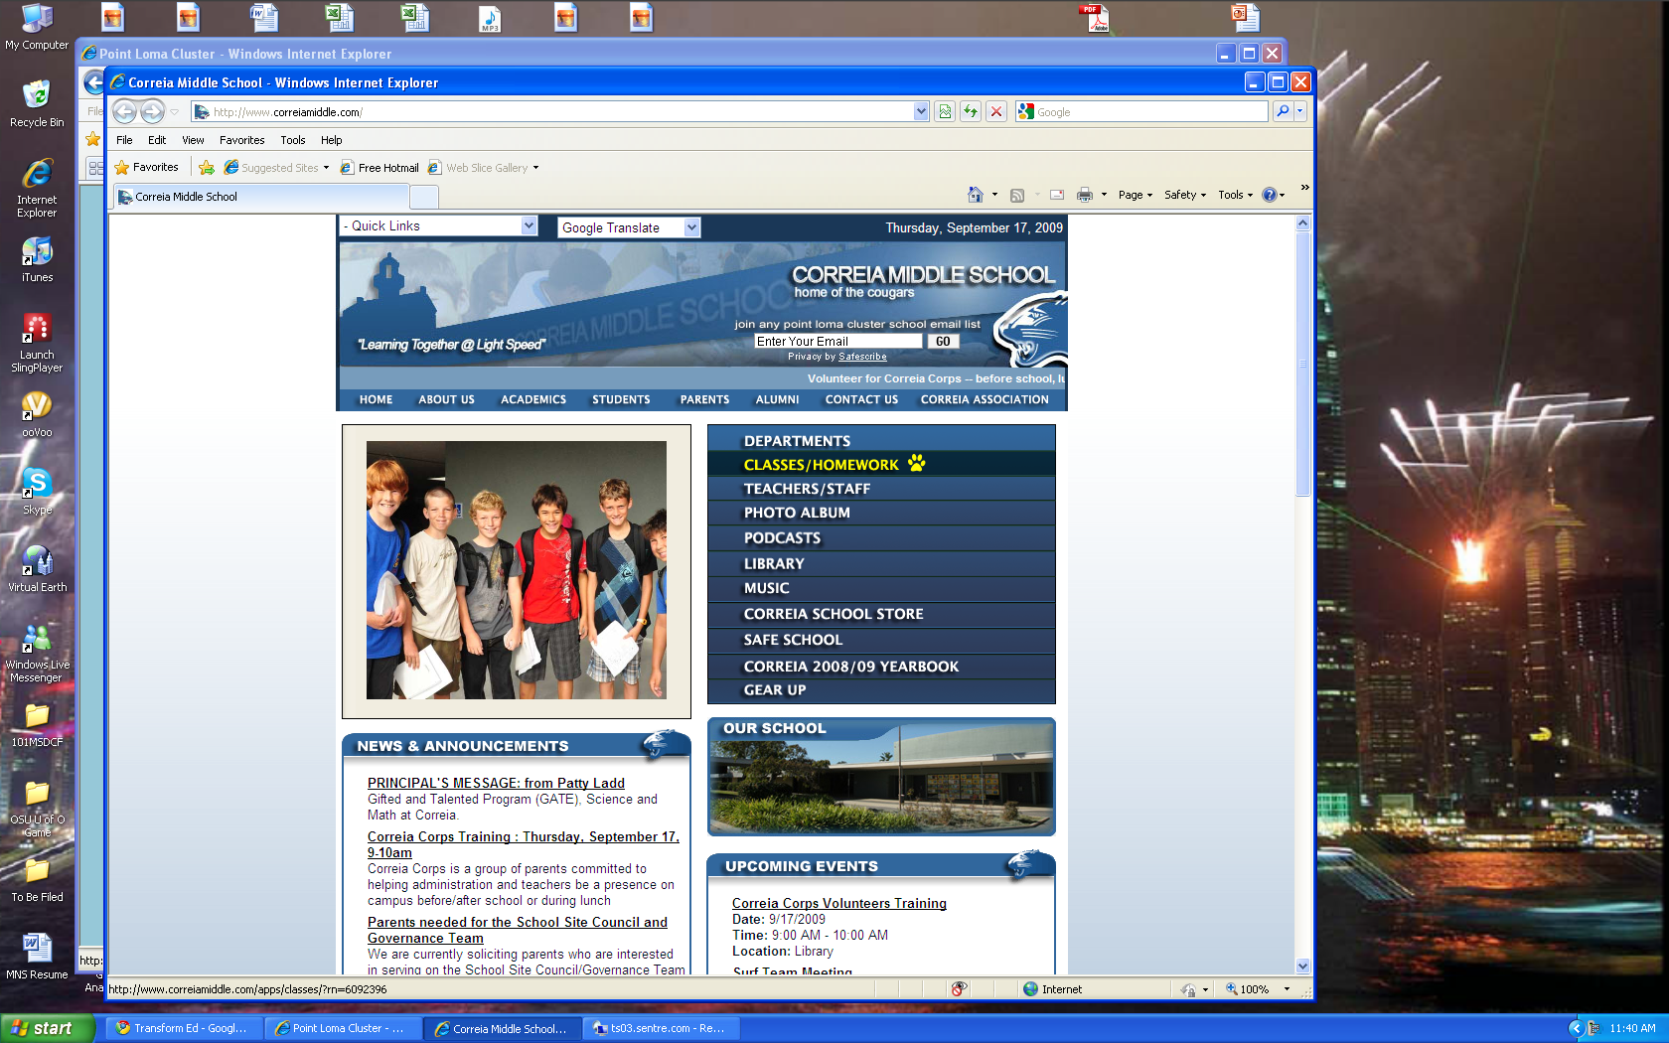
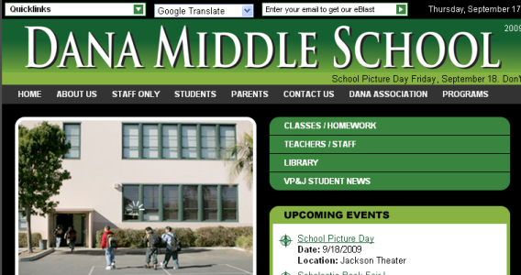
Cluster Overview
Cluster Quick Facts
10 schools
Over 6,000 students / App. 500+/- per grade
15% English Language Learners
45% Qualify For Free Lunch
30% GATE students
14% Students with disabilities
67% Proficient in English Language Arts (2009)
66% Proficient in Math (2009)
Student Population
  1/3 grades K – 4
  1/3 grades 5 – 8
  1/3 grades 9 -12

Slide 5
Cluster Demographics 2009
10 schools, over 6,200 students…..diversity is a strength of our Cluster schools.

Slide 6
School Demographics - 2009
Cluster student population by cluster school…….

Slide 7
School Population - 2009
Elementary schools range between 200 and 400 students….

Slide 8
Student Demographics – English Lang. Learners - 2009
15% of Cluster students are English Language Learners (ELL) by school……

Slide 9
Student Demographics – Free Lunch - 2009
46% of Cluster students qualify for free lunch program.

Slide 10
Student Demographics – GATE Students - 2009
30% of Cluster students are GATE.

Slide 11
Student Demographics – Students w/ Disabilities - 2009
10% of Cluster students with learning disabilities – special education.

Slide 12


About The
Academic Performance Index (API)
and
Adequate Yearly Progress (AYP)

Slide 13
Understanding API and AYP
API = Academic Performance Index
How much a school is improving year to
year based on its API.
Target = 800. If less, school must meet annual target
All subgroups do not need to meet for school to pass.
Subgroups (Ethnic and Racial)
White
Hispanic
African American
Filipino
Asian
Pacific Islander
Other
Socioeconomic Disadvantaged
English Language Learners
Students with Disabilities
API and AYP Define Subgroups
AYP = Adequate Yearly Progress
How well schools are meeting common
standards of academic performance
Target = % of students proficient
School and subgroups must meet for school to pass

Slide 14
Understanding API and AYP
API Target 800 (Range 200 to 1000)
2008 Base 2008-09 Target
200 – 690 5% of the difference between Base API target of 800
691 – 795 Gain of 5 points
796 Gain of 4 points
797 Gain of 3 points
798 Gain of 2 points
799 Gain of 1 point
800 or more Must maintain at least 800
API = Academic Performance Index
How much a school is improving year to
year based on its API.
AYP Target % Proficient - 2009
School and all subgroups must meet AYP Target Proficient
Level for Math and English Language Arts.
Elementary / Middle Schools
Math = 46.0%
English-Language Arts = 47.5%
High School
Math = 44.5%
English-Language Arts = 43.5%
AYP = Adequate Yearly Performance
How well schools are meeting common
standards of academic performance.

Slide 15
Understanding API and AYP
Adequate Yearly Performance (AYP)
AYP Is a Series of academic goals set by state
Criteria:
1. Student Participation on Statewide tests
2. % of students scoring at the “Proficiency Level” or above in English
Language Arts (ELA) and Math (Schoolwide and Subgroups)
3. API Growth (min of 620 School API or 1 point)
4. Graduation Rate (at least 83%)
Subgroups Must Have Significant Student Population To Count
Schools that fail to meet AYP for 2 consecutive years go into Program Improvement (PI).

Slide 16
Key Changes to the 2009 AYP and 2009-10 PI Reports
The required percentage of students proficiency:
Elementary Schools & Middle schools
English-language arts (ELA) 46.0%
Mathematics 47.5%
High Schools
English-language arts (ELA) 44.5%
Mathematics 43.5%
To meet the API requirement for AYP purposes, a school must demonstrate a growth of at least one point or a minimum API score of at least 650.
To meet the graduation rate requirement, a high school must demonstrate an improvement of at least 0.1 from the previous year’s rate or an improvement in the rate of at least 0.2 in the average two-year rate or a minimum rate of at least 83.1.
The AYP targets will continue to increase annually until 2014.

Slide 17
Program Improvement School Alternatives – Restructuring
Year / Did Not Meet AYP | Three | Four | Five | Six | Seven
 | School Improvement | School Improvement | Corrective Action | Restructuring | Restructuring
PI Year | Year 1 | Year 2 | Year 3 | Year 4 | Year 5
Restructure Alternatives
Close the school and reopen it as a charter school
Replace all or most of the school staff (which may include the principal) who are relevant to the failure to make AYP
Enter into a contract with an entity, such as a private management company with a demonstrated record of effectiveness, to operate the public school
Turn the operation of the school over to the SEA, if permitted under law and agreed to by the state. (This is not an available option in California.)
Implement any other major restructuring of the school’s governance arrangement that makes fundamental reforms and leads to improved student achievement
http://www.cde.ca.gov/TA/ac/ti/schoolpireq.asp

Slide 18
API 5 Years - Elementary Schools
913
893
865
API Target
800
824
API
785
772
Similar
Schools
API for elementary schools
Note *Barnard not large enough student population to be statistically relevant.

Slide 19
API 2009 Breakdown - Elementary Schools
API Target
800
API
API closer between schools when comparing ethnic subgroups and socioeconomics.
*Dewey and Barnard not large enough student population to be statistically relevant.

Slide 20
API 5 Years – Middle and Upper Schools (5-12)
847
API Target
800
778
API
761
Similar
Schools

Slide 21
API 2009 Breakdown – 6 thru 12 Schools
API Target
800
API

Slide 22
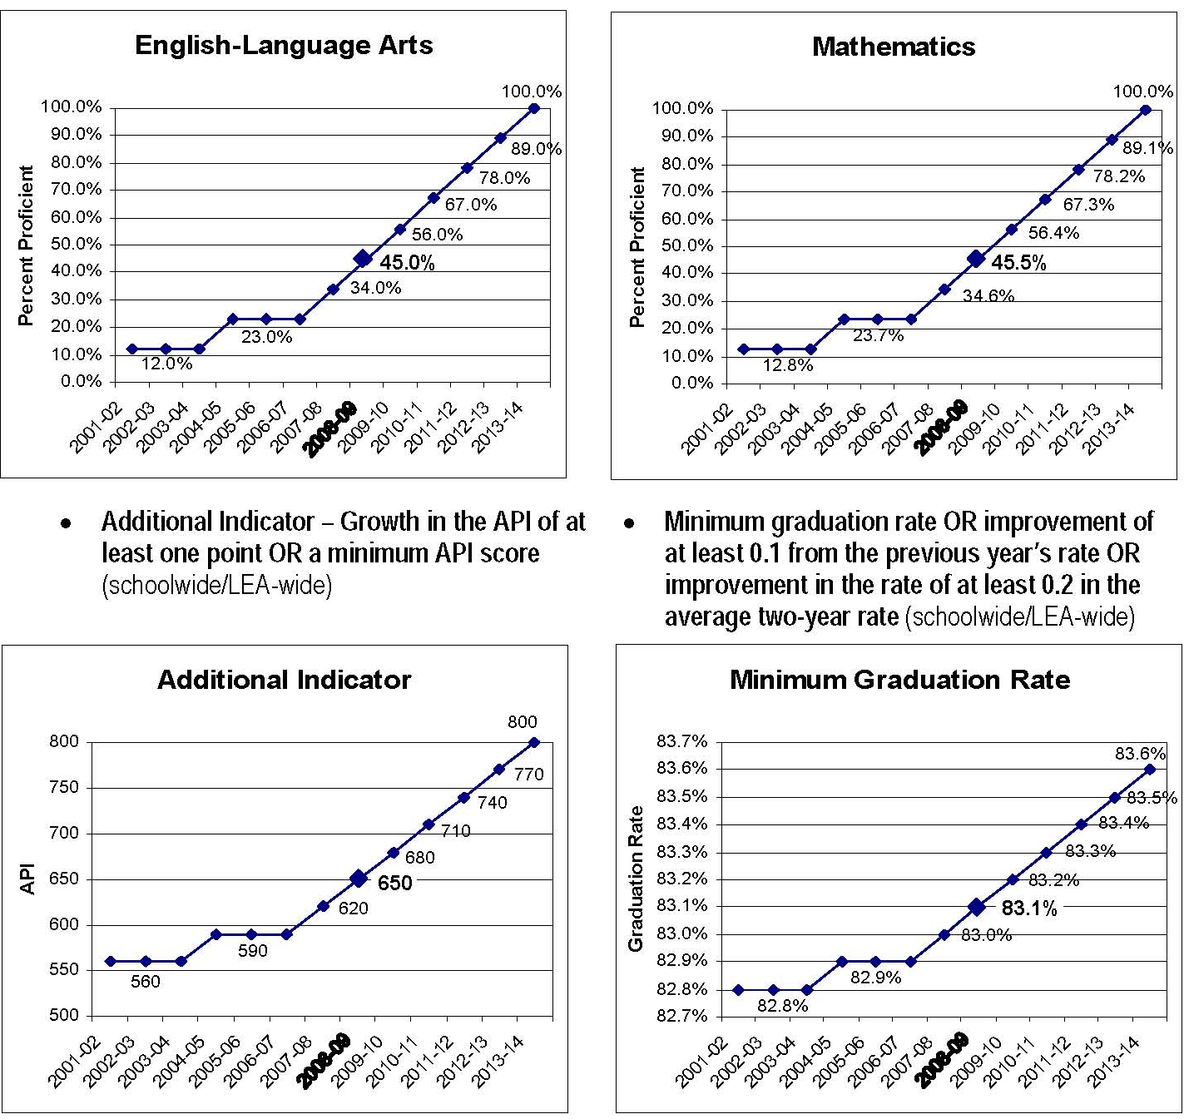
AYP Targets - 2002 – 2014
High Schools

Slide 23
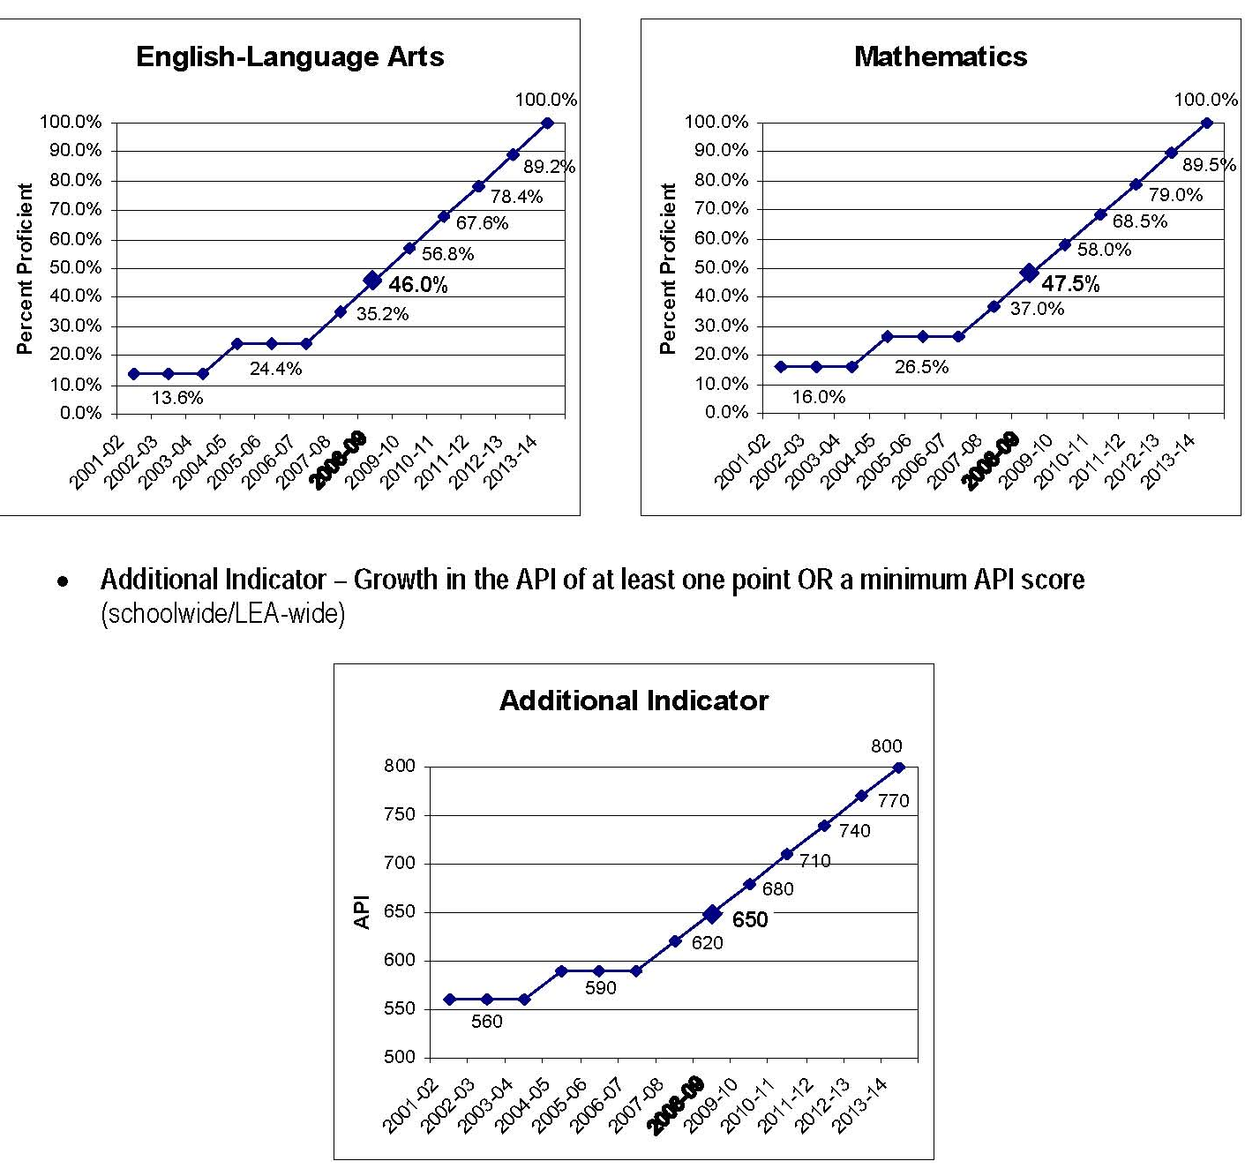
AYP Targets - 2002 – 2014
Elementary & Middle Schools

Slide 24
Proficiency Levels - ELA 2009 - Elementary Schools
API
Target
46%
All elementary schools met ELA target levels of proficiency
*Subgroups that show below proficiency may not have large enough student population to be statistically relevant.

Slide 25
Proficiency Levels - Math 2009 - Elementary Schools
API
Target
47.5%
All elementary schools met Math target levels of proficiency
*Subgroups that show below proficiency may not have large enough student population to be statistically relevant.

Slide 26
Proficiency Levels - ELA 2009 – Middle/High Schools
API
Target
46.0%
Target
44..5%
Dana met ELA target levels of proficiency – Correia & Point Loma did not
*Subgroups that show below proficiency may not have large enough student population to be statistically relevant.

Slide 27
Proficiency Levels - Math 2009 – Middle/High Schools
API
Target
47.5%
Target
43.5%
Dana met Math target levels of proficiency – Correia & Point Loma did not
*Subgroups that show below proficiency may not have large enough student population to be statistically relevant.

Slide 28
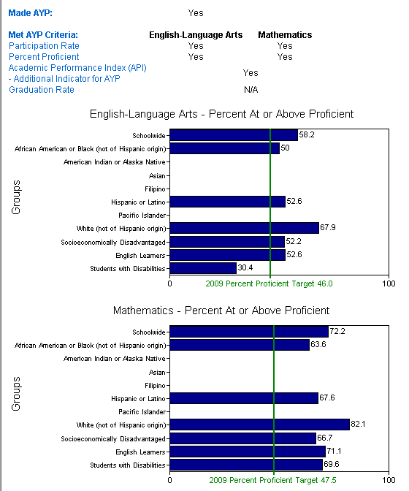
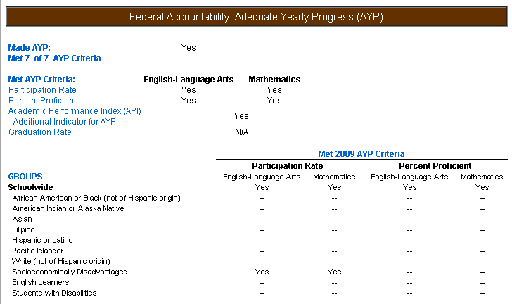
Barnard Elementary
2009 AYP Report
AYP Summary
Met 7 of 7 AYP Criteria
Met AYP - Yes
Note: If Proficiency Target has been met but % below target proficiency, subgroup not large enough to be statistically relevant.

Slide 29
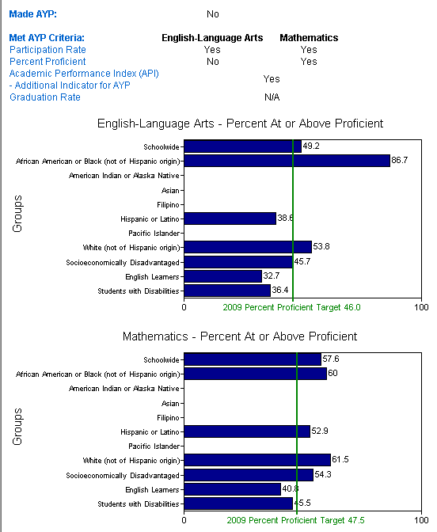
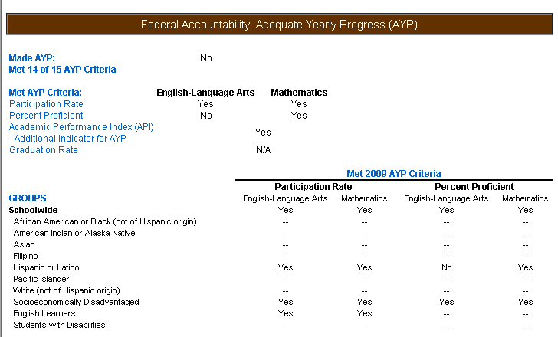
Cabrillo Elementary
2009 AYP Report
AYP Summary
Met 14 of 15 AYP Criteria
Met AYP – No
Year 1 Program Improvement
Note: If Proficiency Target has been met but % below target proficiency, subgroup not large enough to be statistically relevant.

Slide 30
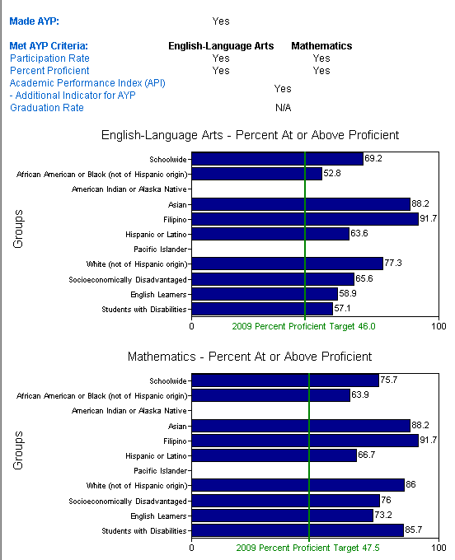

Dewey Elementary
2009 AYP Report
AYP Summary
Met 17 of 17 AYP Criteria
Met AYP - Yes
Note: If Proficiency Target has been met but % below target proficiency, subgroup not large enough to be statistically relevant.

Slide 31
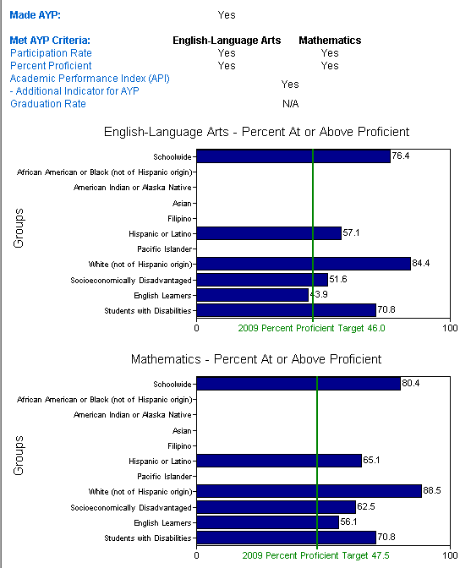

Loma Portal Elementary
2009 AYP Report
AYP Summary
Met 17 of 17 AYP Criteria
Met AYP - Yes
Note: If Proficiency Target has been met but % below target proficiency, subgroup not large enough to be statistically relevant.

Slide 32
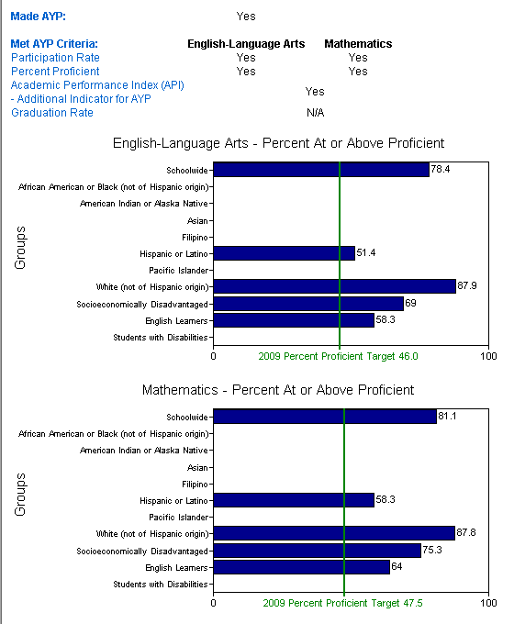

Ocean Beach Elementary
2009 AYP Report
AYP Summary
Met 13 of 13 AYP Criteria
Met AYP - Yes
Note: If Proficiency Target has been met but % below target proficiency, subgroup not large enough to be statistically relevant.

Slide 33
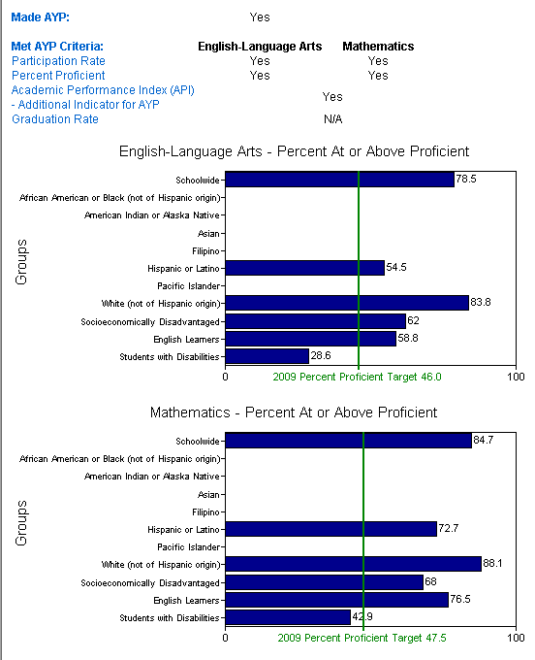
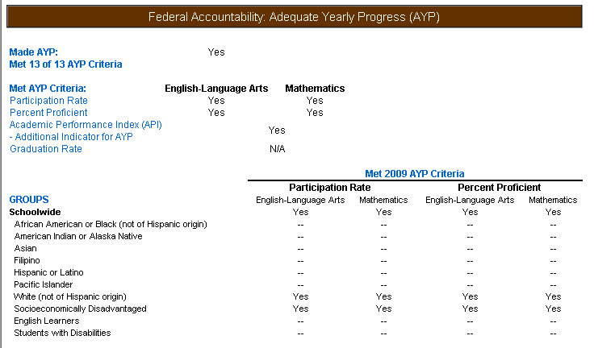
Silver Gate Elementary
2009 AYP Report
AYP Summary
Met 13 of 13 AYP Criteria
Met AYP - Yes
Note: If Proficiency Target has been met but % below target proficiency, subgroup not large enough to be statistically relevant.

Slide 34


Sunset View Elementary
2009 AYP Report
AYP Summary
Met 9 of 9 AYP Criteria
Met AYP - Yes
Note: If Proficiency Target has been met but % below target proficiency, subgroup not large enough to be statistically relevant.

Slide 35
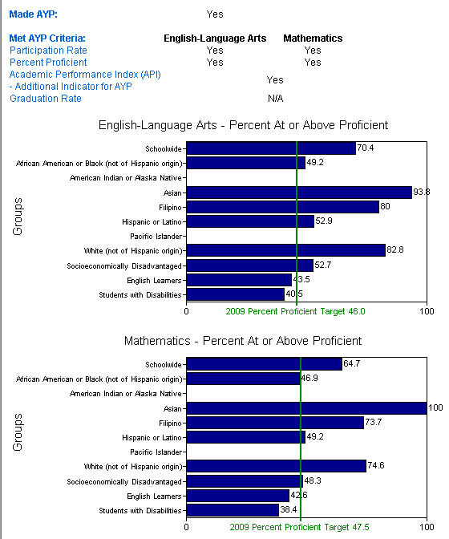

Dana Middle School
2009 AYP Report
AYP Summary
Met 21 of 21 AYP Criteria
Met AYP - Yes
Note: If Proficiency Target has been met but % below target proficiency, subgroup not large enough to be statistically relevant.

Slide 36
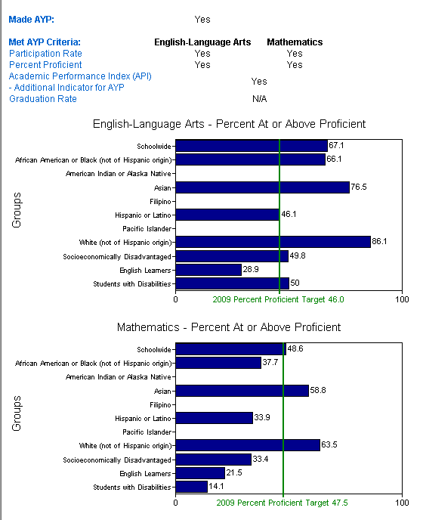

Correia Middle School
2009 AYP Report
AYP Summary
Met 21 of 21 AYP Criteria
Met AYP – Yes (Year 1)
Year 5 of Program Improvement
Note: If Proficiency Target has been met but % below target proficiency, subgroup not large enough to be statistically relevant.

Slide 37

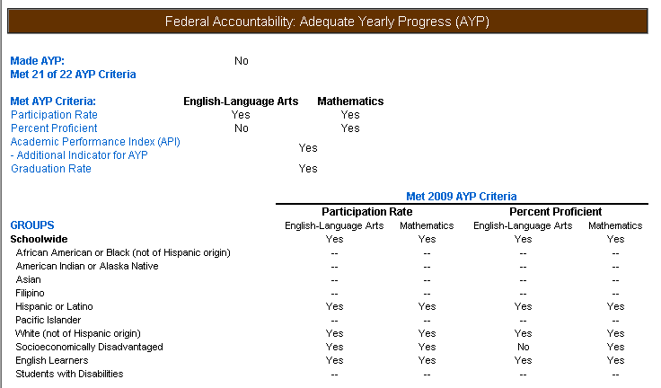
Point Loma High School
2009 AYP Report
AYP Summary
Met 21 of 22 AYP Criteria
Met AYP - No
Year 1 of Program Improvement
Note: If Proficiency Target has been met but % below target proficiency, subgroup not large enough to be statistically relevant.

Slide 38
Appendix

Slide 39
Questions & References
Test Scores API and AYP Results
Annual Yearly Progress (AYP) By School
Academic Performance Index (API) By School
Parent Resources
Overview of the Accountability Progress Reporting System
Parent Guide To School Accountability Reporting
API Home Page State of California
AYP Home Page State of California
Learn More About Our Schools
www.pointlomahigh.com
www.correiamiddle.com
www.danamiddle.com
www.silvergateschool.com
Other cluster schools see www.sandi.net

Slide 40
Questions & References
Learn More About Transforming Education
Ibrary.com
George Lucas Educational Foundation
North Central Regional Educational Lab
Partnership For 21st Century Skills
Tech Learning
eSchool News
Marc Prensky
ICT Literacy
National Educational Foundation
US Department Of Education Technology Plan

